Slide 1
Eco System Model And Work Flow

Slide 2
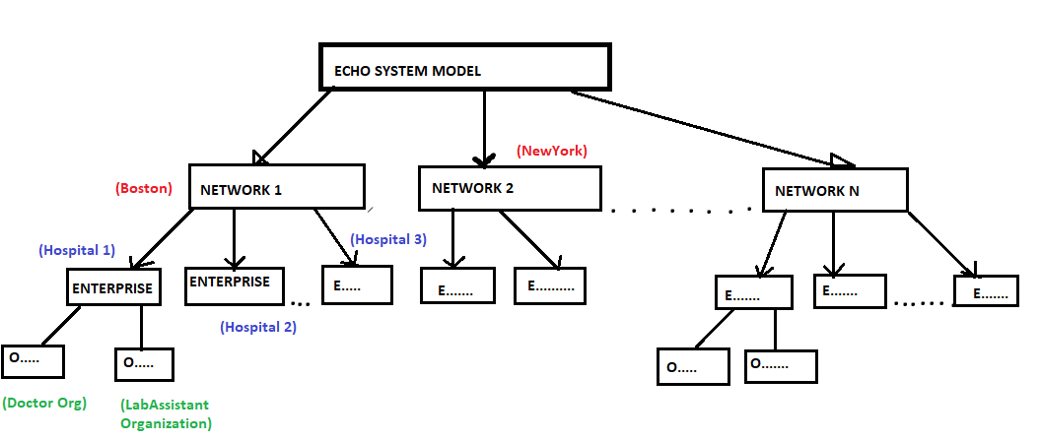

Slide 3
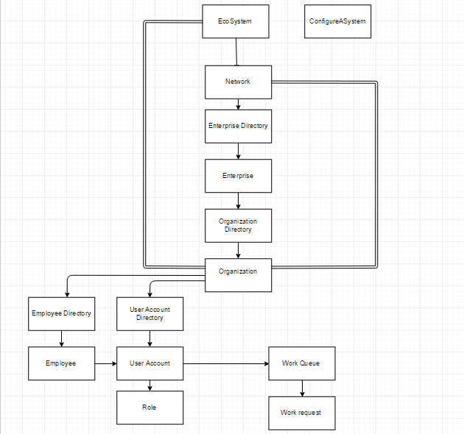

Slide 4
Work Request
To do some work --------------initiate a work request.
The Work involves doing something.
The request has to be sent from Someone
The request needs to be sent to someone

Slide 5
